Slide 1
MongoDB
Basic to Intermediate

Slide 2
Agenda
Day 1
Database Evolution
SQL vs NoSQL
NoSQL Types
JSON and BSON
MongoDB overview
MongoDB Use Cases
Running MongoDB
MongoDB concepts
MongoDB Installation
Day 2
Database Operation
Insert
Update
Delete
Read
MongoDB Compass
Schema Design
Data Modeling
Querying Data
Table-relations vs Aggregations
Installation Python and Node JS
Day 3
MongoDB Native Drivers:
Node.js
Python
.NET
Java
Mongoose
MongoDB with Node.JS
MongoDB with Python

Slide 3
Training Format
Concepts
Hands-on exercises
Challenge/Assignments 15 to 20 min
Interactive

Slide 4
Timing
Start time at 8.30 pm IST
Break 1 - 9.45 pm to 10.00 pm
Break 2 - 11.15 pm to 11.30 pm
End at 12.30 am

Slide 5
Infra setup
MongoDB Community Edition
VS Code

Slide 6

Database
What a database is
A structured collection of data organized for efficient access, retrieval, and management.
Importance of databases in modern computing
From simple data storage to complex data analysis and decision-making.

Slide 7
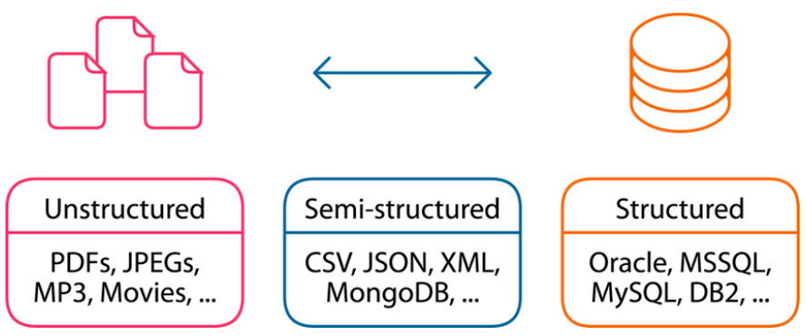
Data Formats

Slide 8
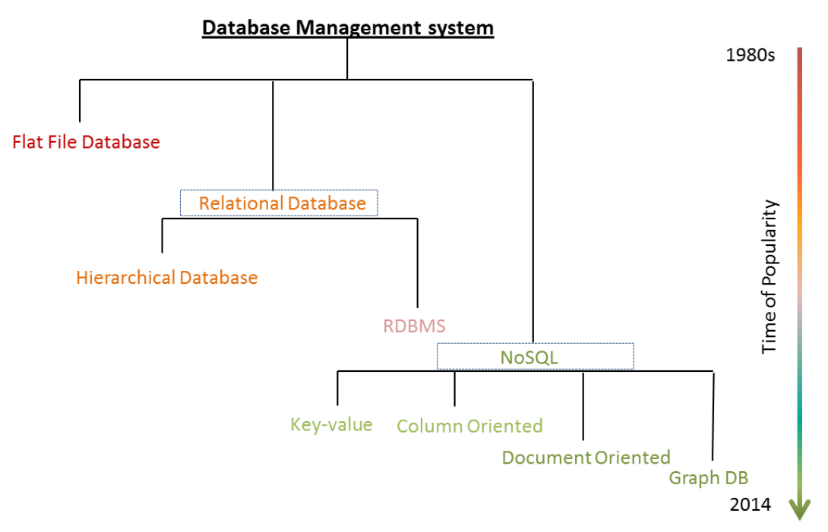
Database Evolution
Notes:
Mention WHY the evolution and benefits of adapting to new practices

Slide 9
Flat File Systems
Characteristics:
Initially, data was stored in flat files, often in text format.
Each file represented a single table, with records separated by delimiters like commas or tabs.
Limitations:
Lack of structure made data organization and retrieval cumbersome.
Data redundancy and inconsistency were common.
Examples:
Early mainframe and desktop applications utilized flat file systems for data storage.
Notes:
Mention WHY the evolution and benefits of adapting to new practices

Slide 10
Hierarchical Databases
Characteristics:
Introduced a hierarchical structure, resembling a tree.
Data organized in parent-child relationships.
Advantages:
Provided better organization and navigation compared to flat file systems.
Examples:
IBM's Information Management System (IMS) was a prominent hierarchical database system.

Slide 11
Relational Databases
Characteristics:
Proposed by Edgar Codd in the 1970s.
Organized data into tables with rows and columns.
Established relationships between tables using keys.
Advantages:
Simplified data management, enhanced data integrity, and provided powerful querying capabilities.
Examples:
Oracle, IBM DB2, MySQL, and PostgreSQL are widely used relational database systems.

Slide 12
NoSQL Databases
Characteristics:
Emerged in response to the limitations of relational databases for certain use cases.
Flexible data models (e.g., document, key-value, columnar, graph).
Scalable and distributed architectures.
Advantages:
Ability to handle unstructured and semi-structured data, high scalability, and performance.
Examples:
MongoDB, Cassandra, Redis, and Neo4j are prominent NoSQL databases

Slide 13
Cloud Databases
Characteristics:
Databases hosted and managed by cloud service providers.
Offer scalability, high availability, and reduced operational overhead.
Advantages:
On-demand resources, global availability, and managed services.
Examples:
Amazon Aurora, Microsoft Azure Cosmos DB, and Google Cloud Bigtable are popular cloud databases.

Slide 14
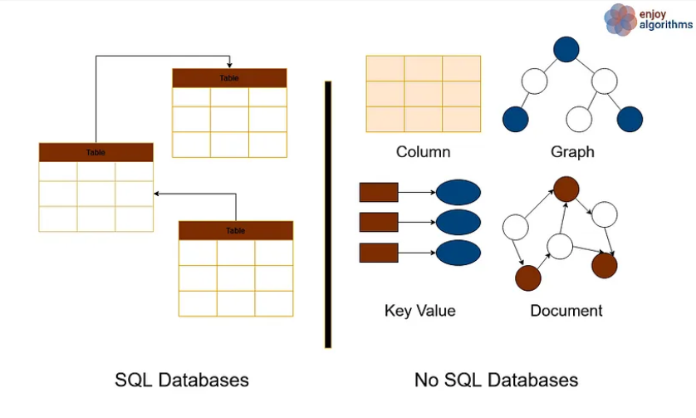
SQL vs NoSQL

Slide 15
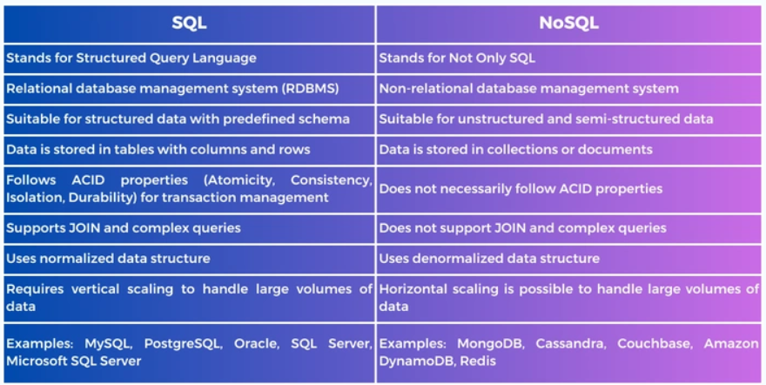
Notes:
https://www.integrate.io/blog/the-sql-vs-nosql-difference/

Slide 16
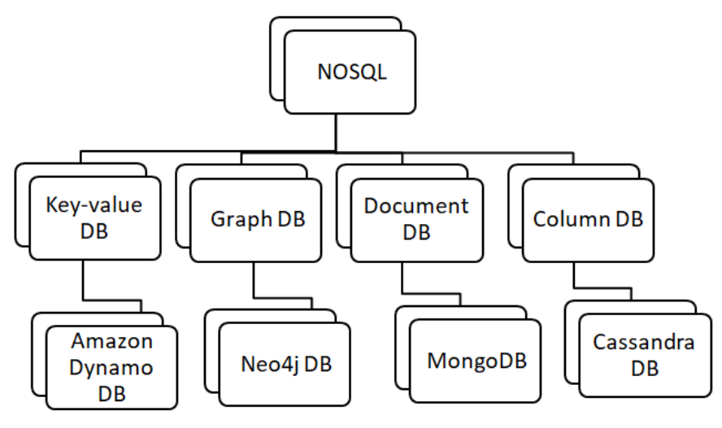
NoSQL Type

Slide 17
Key-Value Stores
Characteristics:
Simplest form of NoSQL databases, storing data as key-value pairs.
Highly scalable and efficient for read and write operations.
Use Cases:
Session management, caching, distributed systems.
Examples:
Redis, Amazon DynamoDB, Riak.

Slide 18
Graph Databases
Characteristics:
Model and store data as nodes, edges, and properties.
Optimize for traversing relationships and graph-based queries.
Use Cases:
Social networks, recommendation systems, fraud detection.
Examples:
Neo4j, Amazon Neptune, TigerGraph.

Slide 19
Column-Family Stores
Characteristics:
Store data in columns rather than rows, organized in column families.
Optimize for read-heavy workloads and analytical queries.
Use Cases:
Time-series data, analytics, data warehousing.
Examples:
Apache Cassandra, HBase, ScyllaDB

Slide 20
Document Stores
Characteristics:
Organize data into flexible, schema-less documents (e.g., JSON, BSON).
Documents can contain nested structures and arrays.
Use Cases:
Content management systems, e-commerce platforms, real-time analytics.
Examples:
MongoDB, Couchbase, CouchDB.

Slide 21
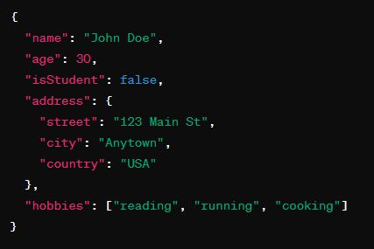
JSON
JSON (JavaScript Object Notation) is a lightweight data interchange format that is easy for humans to read and write and easy for machines to parse and generate.
It is widely used for transmitting data between a server and a web application, as well as for configuration files and storing structured data.
https://www.json.org/json-en.html

Slide 22
Key Characteristics of JSON
Simple Syntax:
JSON data is represented using a straightforward syntax consisting of key-value pairs.
Data is organized into objects (enclosed in curly braces {}) and arrays (enclosed in square brackets []).
Each key-value pair is separated by a colon (:), and pairs are separated by commas.

Slide 23
Key Characteristics of JSON
Data Types:
JSON supports several data types, including:
Strings: Enclosed in double quotes (" ").
Numbers: Integers or floating-point numbers.
Booleans: true or false.
Arrays: Ordered lists of values.
Objects: Unordered collections of key-value pairs.
null: Represents a null value.

Slide 24
Key Characteristics of JSON
Nested Structures:
JSON allows for nested data structures, where objects or arrays can contain other objects, arrays, or primitive values.
This enables the representation of hierarchical data and complex relationships.
Human Readable:
JSON is designed to be easy for humans to read and write, making it a popular choice for data interchange and configuration files.
Its syntax is concise and well-structured, facilitating readability and comprehension.

Slide 25
Key Characteristics of JSON
Language Agnostic:
JSON is language agnostic, meaning it can be parsed and generated by virtually any programming language.
Most programming languages provide built-in support or libraries for working with JSON data.

Slide 26
Use Cases of JSON
Web APIs:
JSON is commonly used as the data format for APIs, allowing web applications to retrieve and manipulate data from servers.
Configuration Files:
Many software applications use JSON for configuration files due to its readability and flexibility.
Data Interchange:
JSON facilitates data interchange between different systems and platforms, making it suitable for data transfer over the internet.
Frontend Development:
JSON is frequently used in frontend development for managing state, storing data, and configuring user interfaces.

Slide 27
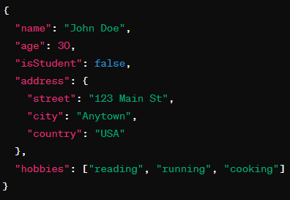
BSON
BSON (Binary JSON) is a binary-encoded serialization format used primarily to store and exchange documents in MongoDB, a popular NoSQL database.
BSON extends the JSON format by adding additional data types and binary encoding, making it more efficient for storage and transmission over the network.
The equivalent BSON document would be the binary representation of this JSON document, with additional binary-encoded data types where applicable.
https://bsonspec.org/

Slide 28
Key Characteristics of BSON
Binary Encoding:
BSON documents are encoded in a binary format, which is more compact and efficient compared to plain text JSON.
Binary encoding allows for faster parsing and serialization/deserialization operations.
Ordered Key-Value Pairs:
BSON documents maintain the order of key-value pairs, unlike JSON, which does not guarantee order.
This allows for more predictable document structure and facilitates efficient storage and retrieval.

Slide 29
Key Characteristics of BSON
Extended Data Types:
BSON supports additional data types beyond those supported by JSON, including:
Date: Represents date and time information.
Binary Data: Stores binary data such as images, files, or serialized objects.
Regular Expression: Represents regular expression patterns.
ObjectId: A unique identifier used as a primary key in MongoDB.
Decimal128: Represents arbitrary-precision decimal numbers.
JavaScript Code: Stores JavaScript code for execution within MongoDB queries.

Slide 30
Key Characteristics of BSON
Efficient Storage and Querying:
BSON's binary encoding results in more compact storage compared to JSON, reducing storage requirements and improving performance.
BSON documents can be efficiently indexed and queried using MongoDB's query language and indexing mechanisms.
Compatibility with MongoDB:
BSON is the native format used by MongoDB to store documents in collections.
MongoDB drivers and libraries automatically handle BSON serialization and deserialization when interacting with the database.

Slide 31
MongoDB Overview
MongoDB is a popular open-source NoSQL database known for its flexibility, scalability, and ease of use.

Slide 32
Key Features of MongoDB
Document-Oriented:
MongoDB stores data in flexible, JSON-like documents called BSON (Binary JSON). These documents can have varying structures, allowing for easy representation of complex data types and relationships.
Dynamic Schema:
Unlike traditional relational databases, MongoDB does not enforce a fixed schema. Each document can have its own unique structure, and fields can be added or modified without requiring a schema migration.

Slide 33
Key Features of MongoDB
Scalability:
MongoDB is designed to scale horizontally, meaning it can distribute data across multiple servers or clusters to handle increasing load and data volume. This enables seamless scaling of applications as they grow.
High Performance:
MongoDB offers high performance for both read and write operations, with support for indexing, sharding, and in-memory storage. It can efficiently handle real-time data ingestion and analytics workloads.

Slide 34
Key Features of MongoDB
Rich Query Language:
MongoDB provides a powerful query language with support for CRUD operations (Create, Read, Update, Delete), aggregation, indexing, and full-text search. It also supports geospatial queries for location-based data.
Replication and High Availability:
MongoDB supports replica sets, which are groups of MongoDB instances that maintain copies of the same data. This ensures high availability and fault tolerance, with automatic failover in case of node failures.

Slide 35
Key Features of MongoDB
Horizontal Sharding:
MongoDB uses sharding to distribute data across multiple servers or shards, allowing for linear horizontal scaling. Sharding helps distribute data evenly and improves query performance by parallelizing operations.
Security:
MongoDB offers various security features, including authentication, authorization, encryption at rest, and auditing. It also supports role-based access control (RBAC) for fine-grained access control.

Slide 36
Use Cases
Content Management:
MongoDB is well-suited for content management systems, allowing efficient storage and retrieval of structured and unstructured data.
Real-Time Analytics:
MongoDB's flexible data model and rich query capabilities make it ideal for real-time analytics and reporting applications.

Slide 37
Use Cases
IoT and Sensor Data:
MongoDB's scalability and support for time-series data make it a preferred choice for storing and analyzing IoT and sensor data.
Mobile and Web Applications:
MongoDB's ease of use and scalability make it a popular choice for building modern mobile and web applications.

Slide 38
Use Cases
Catalog and Product Data:
MongoDB's document-oriented nature is well-suited for storing catalog and product data in e-commerce platforms.
User Profiles and Personalization:
MongoDB enables the storage and retrieval of user profiles and personalized content in applications such as social networks and recommendation engines.

Slide 39
mongodb concepts
Database:
A database in MongoDB is a container for collections. Each database gets its own set of files on the file system.
Collection:
A collection in MongoDB is a group of documents. It is the equivalent of a table in relational databases. Collections do not enforce a schema, meaning documents within a collection can have different structures.
Document:
A document is a basic unit of data in MongoDB, similar to a row in a relational database. It is represented as a JSON-like object with key-value pairs. Documents in a collection can have different fields and data types.

Slide 40
mongodb concepts
Field:
A field is a key-value pair within a document. Each field has a name (key) and a value. Values can be of various data types, including strings, numbers, arrays, objects, dates, and binary data.
ObjectId:
An ObjectId is a unique identifier generated by MongoDB for each document in a collection. It consists of a 12-byte hexadecimal number, typically represented as a 24-character string. ObjectId values are automatically generated by MongoDB when inserting documents into a collection.

Slide 41
Ecosystem
MongoDB Atlas:
MongoDB offers a fully managed cloud database service called MongoDB Atlas, providing automated provisioning, scaling, and backup of MongoDB clusters in the cloud.
MongoDB Compass:
MongoDB Compass is a graphical user interface (GUI) tool for MongoDB that allows developers to visualize and interact with their data, perform ad-hoc queries, and create indexes.

Slide 42
Ecosystem
MongoDB Stitch:
MongoDB Stitch is a serverless platform provided by MongoDB for building modern, serverless applications with MongoDB as the backend.
MongoDB Community:
MongoDB has a vibrant community of developers and contributors who actively contribute to the development and improvement of the MongoDB ecosystem.

Slide 43
Install MongoDB
https://docs.google.com/document/d/1Xo6R21Zja9_2jrNhJ4Q2CRzvLLZ3dq4xNe5GQKy2Erc/edit?usp=sharing

Slide 44
Day 2
Database Operation
Insert
Update
Delete
Read
Schema Design
Data Modeling
Querying Data
Table-relations vs Aggregations

Slide 45
Commands
Show Databases:
Use the show dbs command to display a list of databases.
Switch Database:
Use the use <database> command to switch to a specific database.
Create Database:
Use the use <database> command to create new database.
Show Collections:
Use the show collections command to display a list of collections in the current database.
Drop Database:
db.dropDatabase()

Slide 46
Commands
Insert Data:
Use the db.<collection>.insertOne() or db.<collection>.insertMany() commands to insert documents into a collection.
Query Data:
Use the db.<collection>.find() command to query documents from a collection.

Slide 47
Insert
The db.collection.insertOne() method in MongoDB is used to insert a single document into a specified collection within a database:
db: This refers to the current database you are working with in the MongoDB shell.
collection: This is the name of the collection where you want to insert the document.
insertOne(): This is the method used to insert a single document into the specified collection. It takes a single argument, which is the document to be inserted. The document must be in JSON format and can contain any valid JSON data, including nested objects and arrays.

Slide 48
Insert commands
use mydatabase
db.createCollection("mycollection")
db.mycollection.insertOne({ "name": "John Doe", "age": 30 })
db.mycollection.insertOne({ "name": "John Doe", "age": 30, "email": "john@example.com", "address": { "street": "123 Main St", "city": "Anytown", "country": "USA" } })

Slide 49
Commands
Update Data:
Use the db.<collection>.updateOne() or db.<collection>.updateMany() commands to update documents in a collection.
Delete Data:
Use the db.<collection>.deleteOne() or db.<collection>.deleteMany() commands to delete documents from a collection.

Slide 50
Sample exercise
use mydatabase
db.createCollection("myCollection")
db.myCollection.insertOne({ "name": "John Doe", "age": 30 })
db.myCollection.find()
db.myCollection.updateOne({ "name": "John Doe" }, { $set: { "age": 31 } })
db.myCollection.deleteOne({ "name": "Bob Johnson" })

Slide 51
Assignment
Add new document in the existing collection
Create new collection
Insert 2 document with different fields
Read documents
Update the document
Delete document
Delete Collection
Delete Database

Slide 52
mongodb compass
MongoDB Compass is the official graphical user interface (GUI) for MongoDB. It provides users with a visually appealing and intuitive way to interact with MongoDB databases.

Slide 53
Key Features
Visual Representation: MongoDB Compass offers a graphical representation of MongoDB data, making it easy for users to explore and understand their databases visually.
Schema Analysis: It provides schema visualization and analysis tools to understand the structure of collections, including data types, indexes, and relationships between collections.
Data Exploration: Users can browse and query MongoDB collections, view documents, and analyze data using a variety of filters and aggregation pipelines.
Index Management: MongoDB Compass allows users to create, modify, and drop indexes to optimize query performance and improve database efficiency.

Slide 54
Key Features
Real-Time Monitoring: It offers real-time performance monitoring and diagnostic tools to track database metrics, including server status, network activity, and query performance.
Query Builder: Users can build and execute MongoDB queries using a visual query builder interface, making it easier to construct complex queries without writing raw MongoDB query syntax.
Data Import/Export: MongoDB Compass provides tools for importing and exporting data to and from MongoDB collections, supporting various file formats and data sources.
Geospatial Analysis: It includes geospatial querying capabilities and visualization tools for working with geospatial data, such as location-based queries and map visualization.

Slide 55
Benefits
Ease of Use: MongoDB Compass offers a user-friendly interface that simplifies database management tasks, making it accessible to both developers and non-technical users.
Productivity: With its visual tools and intuitive features, MongoDB Compass helps users streamline database operations and increase productivity.
Insightful Analysis: It provides powerful analytical tools and visualization capabilities, allowing users to gain insights from their MongoDB data more effectively.
Cross-Platform Compatibility: MongoDB Compass is available for Windows, macOS, and Linux, making it accessible to users on different operating systems.
Integration with MongoDB Ecosystem: MongoDB Compass seamlessly integrates with other MongoDB tools and services, such as MongoDB Atlas (the MongoDB cloud database service) and MongoDB Ops Manager (for database management and monitoring).

Slide 56
Many
db.mycollection.insertMany([
{ "name": "Jane Smith", "age": 25, "email": "jane@example.com", "address": { "street": "456 Elm St", "city": "Othertown", "country": "Canada" } },
{ "name": "Alice Johnson", "age": 35, "email": "alice@example.com", "address": { "street": "789 Oak St", "city": "Anothercity", "country": "UK" } }
])
db.mycollection.updateMany(
{ "age": 30 }, // Filter: Match documents where age is 30
{ $set: { "address.country": "United States" } } // Update: Set the country to "United States"
)

Slide 57
Many & Query
db.mycollection.deleteMany(
{ "age": 30 } // Filter: Match documents where age is less than 30
)
db.mycollection.find({ "age": 30 })
db.mycollection.find({ "address.city": "Anytown" })

Slide 58
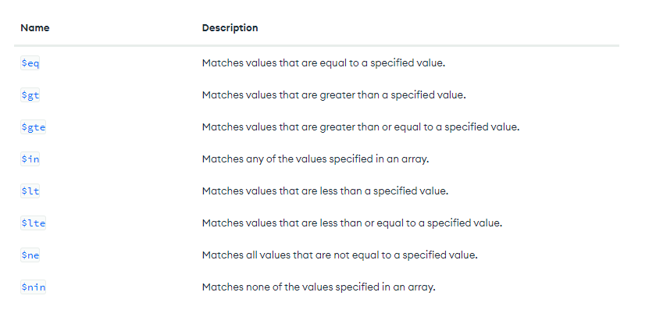
Query Operators

Slide 59
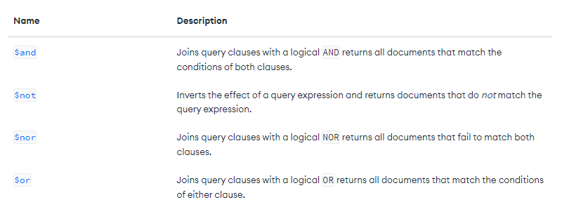
Query Operators
https://www.mongodb.com/docs/manual/reference/operator/query/#query-selectors

Slide 60
Comparison Operators
$eq: Matches values that are equal to a specified value.
db.mycollection.find({ "age": { $eq: 30 } })
$gt: Matches values that are greater than a specified value.
db.mycollection.find({ "age": { $gt: 30 } })
$lt: Matches values that are less than a specified value.
db.mycollection.find({ "age": { $lt: 30 } })
$gte: Matches values that are greater than or equal to a specified value.
db.mycollection.find({ "age": { $gte: 30 } })
$lte: Matches values that are less than or equal to a specified value.
db.mycollection.find({ "age": { $lte: 30 } })

Slide 61
Logical Operators
$and: Joins query clauses with a logical AND and requires that all clauses match.
db.mycollection.find({ $and: [{ "age": { $gte: 25 } }, { "age": { $lte: 35 } }] })
$or: Joins query clauses with a logical OR and requires that at least one of the clauses match.
db.mycollection.find({ $or: [{ "name": "John Doe" }, { "name": "Jane Smith" }] })
$not: Inverts the effect of a query expression and returns documents that do not match the query expression.
db.mycollection.find({ "name": { $not: /^J/ } })

Slide 62
Element Operators:
$exists: Matches documents that have the specified field.
db.mycollection.find({ "email": { $exists: true } })
$type: Matches documents that have the specified data type for the field.
db.mycollection.find({ "age": { $type: "number" } })

Slide 63
Array Operators
$in: Matches any of the values specified in an array.
db.mycollection.find({ "name": { $in: ["John Doe", "Jane Smith"] } })
$all: Matches arrays that contain all elements specified in the query.
db.mycollection.find({ "hobbies": { $all: ["reading", "traveling"] } })

Slide 64
DataTypes
- String:
- Example: "name": "John Doe"
- Integer:
- Example: "age": 30
- Double (Floating-Point Number):
- Example: "price": 49.99
- Boolean:
- Example: "is_active": true

Slide 65
DataTypes
- Date:
- Example: "created_at": ISODate("2022-05-05T12:00:00Z")
- ObjectID:
- Example: "_id": ObjectId("5ff85682e2572d2c08dcbf32")
- Array:
- Example: "tags": ["mongodb", "database", "nosql"]
- Embedded Document:
- Example: "address": {"street": "123 Main St", "city": "Anytown", "country": "USA"}

Slide 66
DataTypes
- Binary Data:
- Example: "avatar": BinData(0, "JVBERi0xLjQKJcOkw7zD...")
- Null:
- Example: "notes": null

Slide 67
Day 3
MongoDB with VS Code
MongoDB Native Drivers:
Node.js
Python
.NET
Java
MongoDB with Python
MongoDB with Node.JS

Slide 68
Installation
Python
https://www.python.org/downloads/
https://www.mongodb.com/docs/languages/python/pymongo-driver/current/get-started/download-and-install/
Node.js
https://nodejs.org/en/download

Slide 69
Exploring bigger dataset
Download sample json data
https://github.com/arjunachari12/mongodb-json-files
Create a new Database and import the above json file using MongoDB Compass

Slide 70
MongoDB VS code extension

Slide 71
Python Basics
https://github.com/arjunachari12/mongodb-json-files

Slide 72
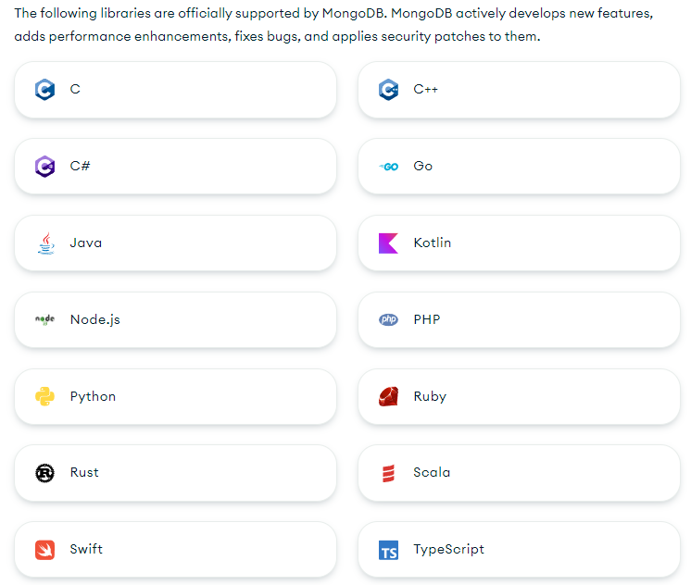
Developing with MongoDB
You can connect your application to your MongoDB Atlas deployment or a self-hosted MongoDB cluster by using one of the official MongoDB libraries.
https://www.mongodb.com/docs/languages/python/

Slide 73
MongoDB PyMongo
Welcome to the documentation site for the official MongoDB PyMongo Driver.
PyMongo is a Python distribution containing tools for working with MongoDB, and is the recommended way to work with MongoDB from Python.
PyMongo is a Python package that you can use to connect to and communicate with MongoDB.
This guide shows you how to create an application that uses PyMongo to connect to a MongoDB cluster hosted on MongoDB Atlas.

Slide 74
Exercise with pymongo
mkdir learn-pymongo
cd learn-pymongo
#create new file sample.py
python3 -m venv venv
source venv/bin/activate
For windows
venv\Scripts\activate
python3 -m pip install pymongo

Slide 75
from pymongo import MongoClient
# connect to mongodb
client = MongoClient("mongodb://localhost:27017/")
db = client["arjun-pymongo-db"]
collection = db["arjuncollection"]
collection.insert_one({"name": "arjun", "age": 30})
result = collection.find_one({"name": "arjun"})
print(result)

Slide 76
Continue with exercise
CRUD with smaller data
CRUD with Bigger data
CRUD with many functions

Slide 77
Installation
Node.js
https://nodejs.org/en/download

Slide 78
Exercise with NodeJS
mkdir learn-jsmongo
cd learn-jsmongo
#create new file sample.js
npm init -y
npm install mongodb@6.5

